Slide 1
Sanexen Data Analysis – Machine Learning
Milad Ramezankhani, PhD Candidate
Dushyant Singh Udawat
Advisors:
Dr. Abbas Milani
Dr. Rudolf Seethaler
September 29th , 2021

Slide 2
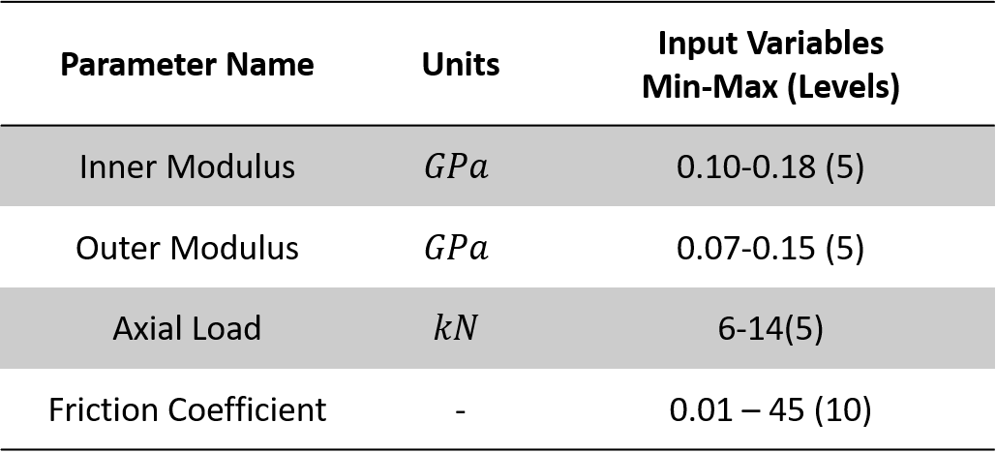

Snaking - Data summary
Outputs:
1
# of snaking occurrence
2
3
4
Global snaking length (m)
5
6
7
Maximum snaking amplitude

Slide 3
Model selection
Model | Interpretability |  | R² Coefficient of Determination (Highest) | R² Coefficient of Determination (Highest) | MSE |  | Training Speed
Number of Snaking
Linear Regression | High | 0.321 |  |  |  | 4.268 | High
SVR | Low | 0.545 |  |  |  | 2.856 | Low
Decision Tree(*) | High | 0.600 |  |  |  | 2.508 | High
XGBoost(**) | Low | 0.602 |  |  |  | 2.500 | Low
Global Length of Snaking
Linear Regression | High |  | 0.764 |  |  | 41.78 | High
SVR | Low |  | 0.873 |  |  | 23.32 | Low
Decision Tree (*) | High |  | 0.880 |  |  | 21.24 | High
XGBoost (**) | Low |  | 0.881 |  |  | 21.22 | Low
Snaking Amplitude
Linear Regression(*) | High |  | 0.708 |  |  | 0.495 | High
SVR | Low |  | 0.712 |  |  | 0.483 | Low
Decision Tree | High |  | 0.711 |  |  | 0.490 | High
XGBoost(**) | Low |  | 0.723 |  |  | 0.460 | Low

Slide 4
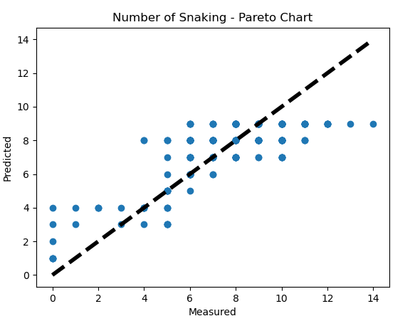
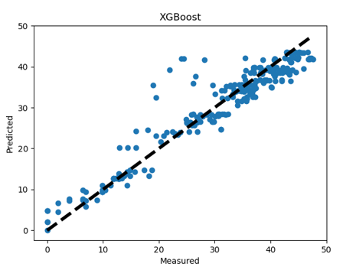
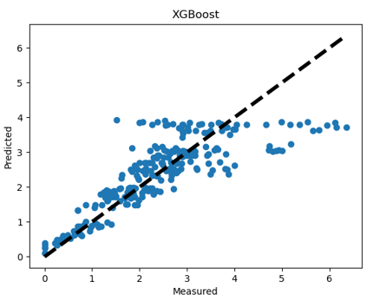
Pareto Charts for Best Models

Slide 5
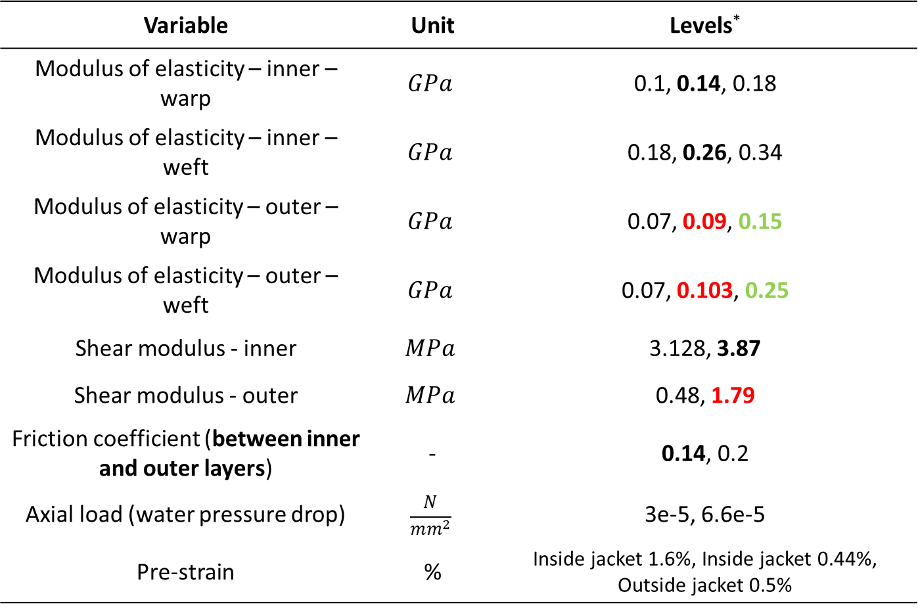
Bunching - Inputs
Variable | Unit | Levels*
Modulus of elasticity – inner – warp | $$GPa$$ | 0.1, 0.14, 0.18
Modulus of elasticity – inner – weft | $$GPa$$ | 0.18, 0.26, 0.34
Modulus of elasticity – outer – warp | $$GPa$$ | 0.07, 0.09, 0.15
Modulus of elasticity – outer – weft | $$GPa$$ | 0.07, 0.103, 0.25
Shear modulus - inner | $$MPa$$ | 3.128, 3.87
Shear modulus - outer | $$MPa$$ | 0.48, 1.79
Friction coefficient (between inner and outer layers) | - | 0.14, 0.2
Axial load (water pressure drop) | $$\frac{N}{mm^{2}}$$ | 3e-5, 6.6e-5
Pre-strain | % | Inside jacket 1.6%, Inside jacket 0.44%, Outside jacket 0.5%

Slide 6
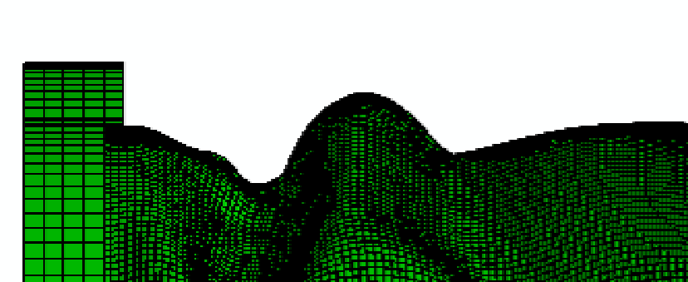
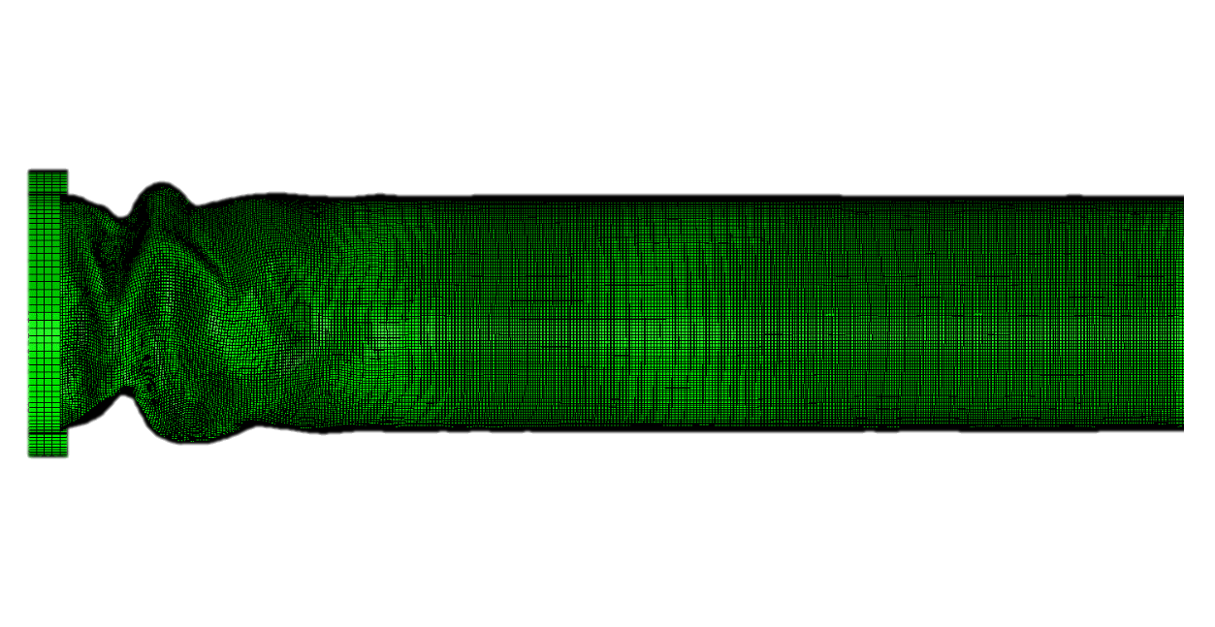
Bunching - Outputs
Maximum bunching amplitude (m)
Reference path
Location of maximum bunching amplitude on the hose (m)

Slide 7
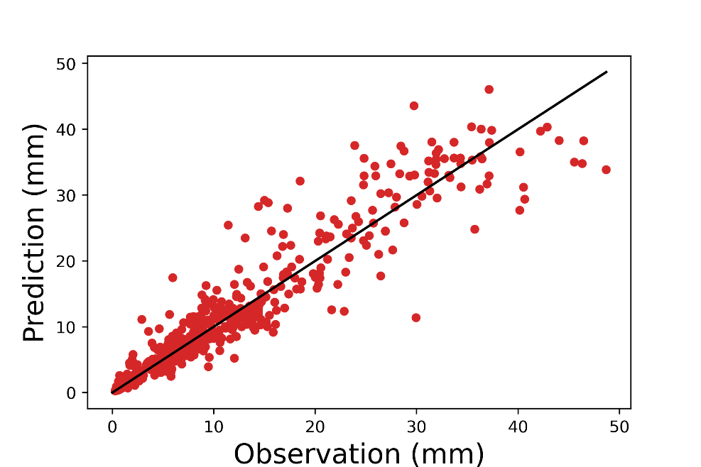
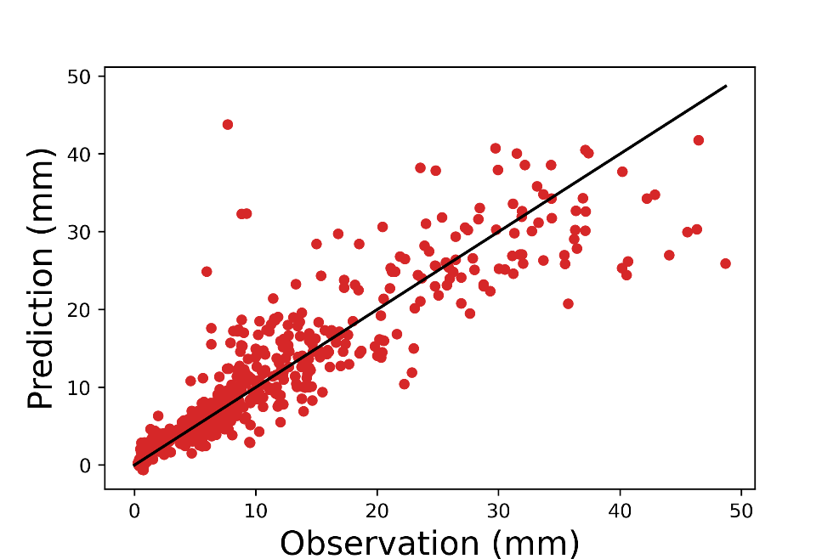
Bunching – ML model performance
Random forest
SVM – RBF kernel
Model | R-squared
Linear regression | 0.66
Ridge regression | 0.67
Random forest | 0.91
Gradient boosting | 0.83
SVM - RBF kernel | 0.84
SVM - Linear | 0.6

Slide 8
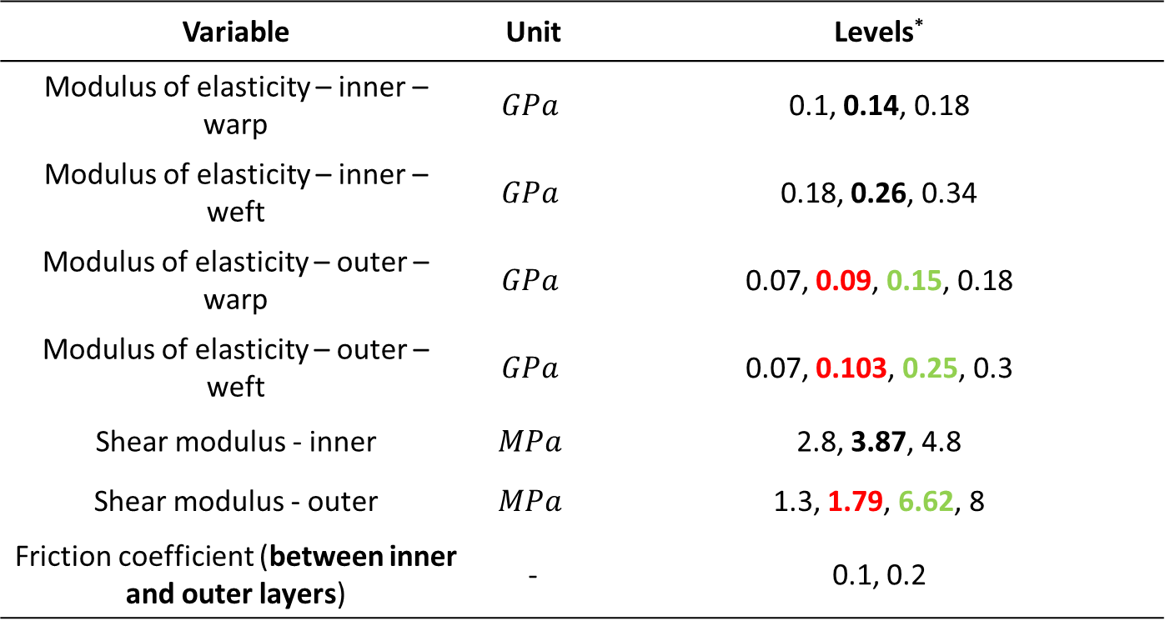
Assembly - Inputs
Variable | Unit | Levels*
Modulus of elasticity – inner – warp | $$GPa$$ | 0.1, 0.14, 0.18
Modulus of elasticity – inner – weft | $$GPa$$ | 0.18, 0.26, 0.34
Modulus of elasticity – outer – warp | $$GPa$$ | 0.07, 0.09, 0.15, 0.18
Modulus of elasticity – outer – weft | $$GPa$$ | 0.07, 0.103, 0.25, 0.3
Shear modulus - inner | $$MPa$$ | 2.8, 3.87, 4.8
Shear modulus - outer | $$MPa$$ | 1.3, 1.79, 6.62, 8
Friction coefficient (between inner and outer layers) | - | 0.1, 0.2
* The level at the center for each variable was derived from characterization experiments.
Outer layer with TPU
Outer layer without TPU

Slide 9
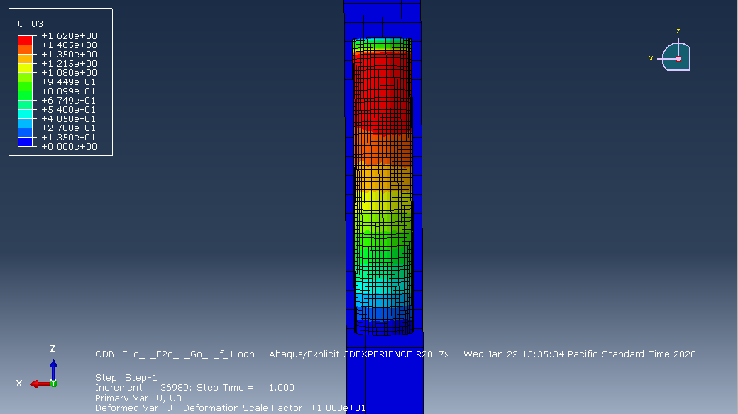

Assembly - Outputs
Excessive length (Deformation in the assembly direction)
Excessive length

Slide 10
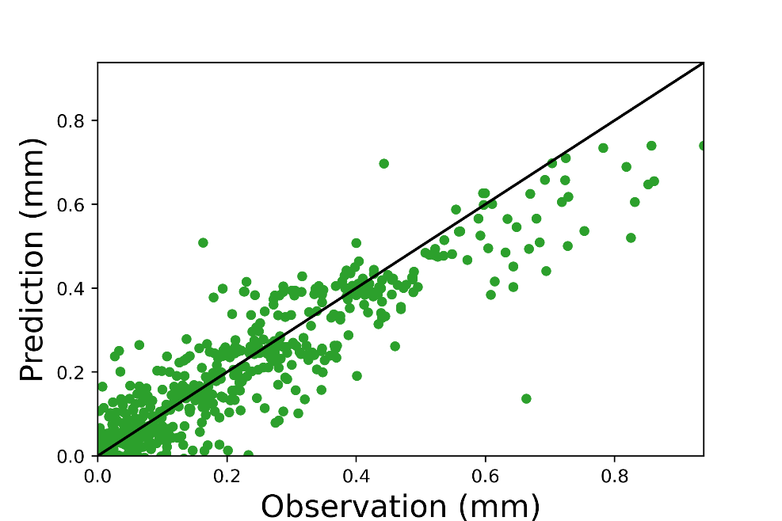
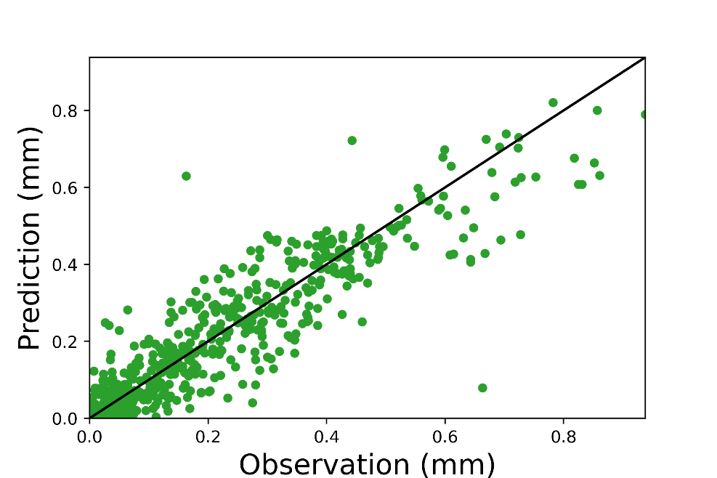
Assembly – ML model performance
Gradient boosting
SVM – RBF kernel
Model | R-squared
Linear regression | 0.63
Ridge regression | 0.63
Random forest | 0.83
Gradient boosting | 0.85
SVM - RBF kernel | 0.85
SVM - Linear | 0.1

Slide 11
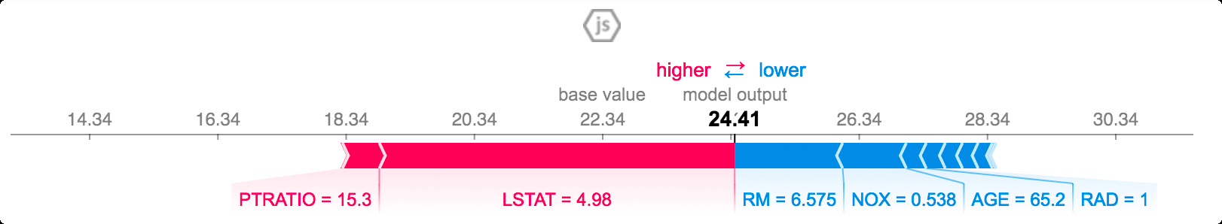
SHAP
Shapley additive explanations (SHAP) is ﻿an additive feature attribution approach based on game theory.
SHAP identifies the contribution of each feature to the model's prediction in an attempt to understand the underlying decision rules learned by the model.
It interprets the model by assigning importance (SHAP) value to each feature in the prediction of any particular instance.

Slide 12
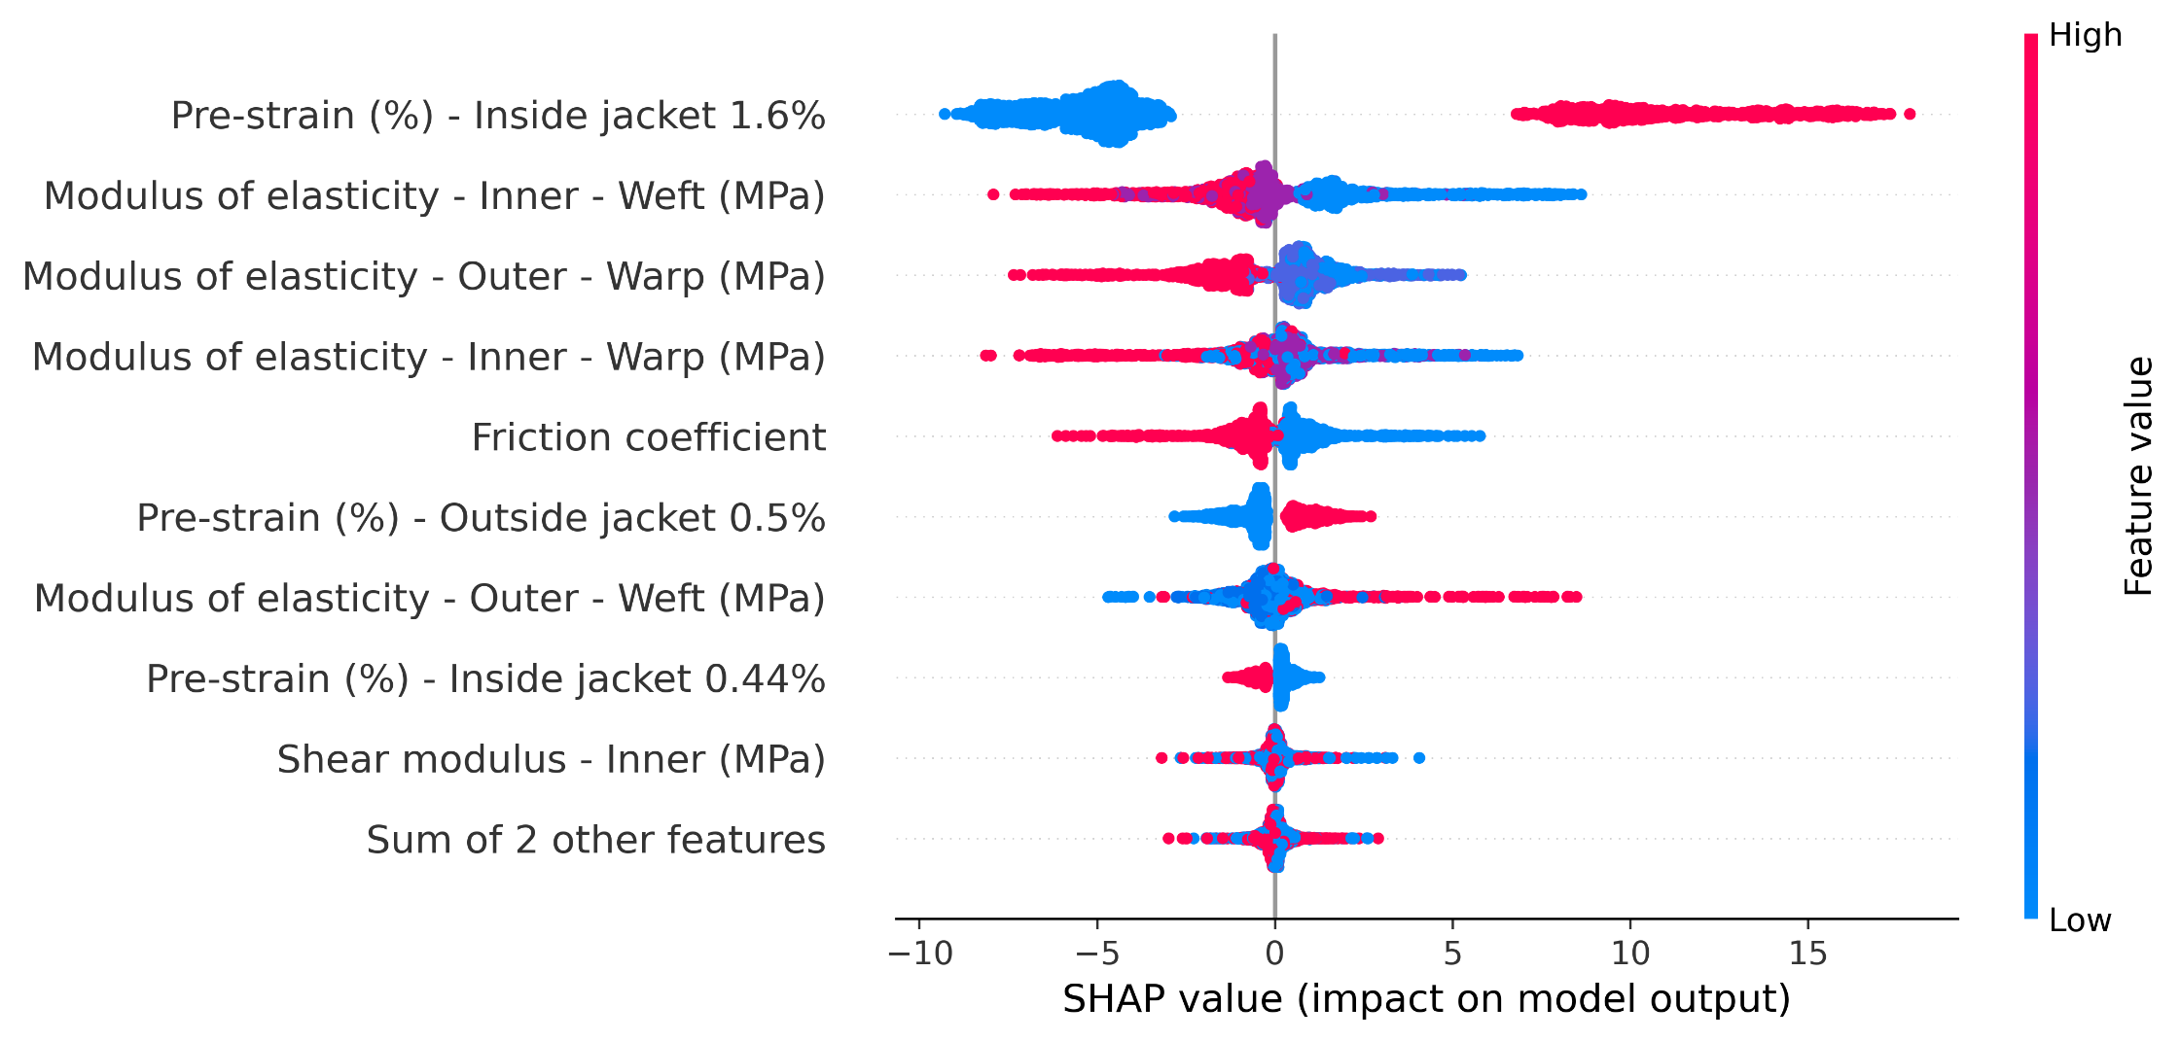
Model explainability analysis - Bunching

Slide 13
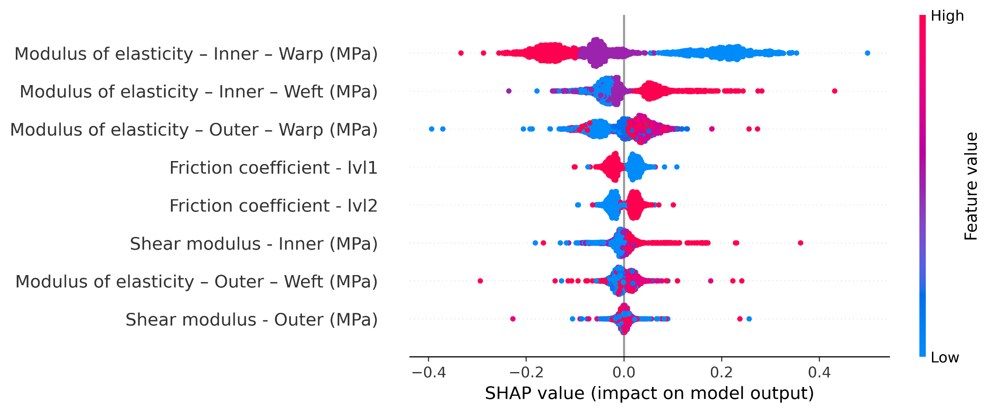
Model explainability analysis - Assembly

